Slide 1
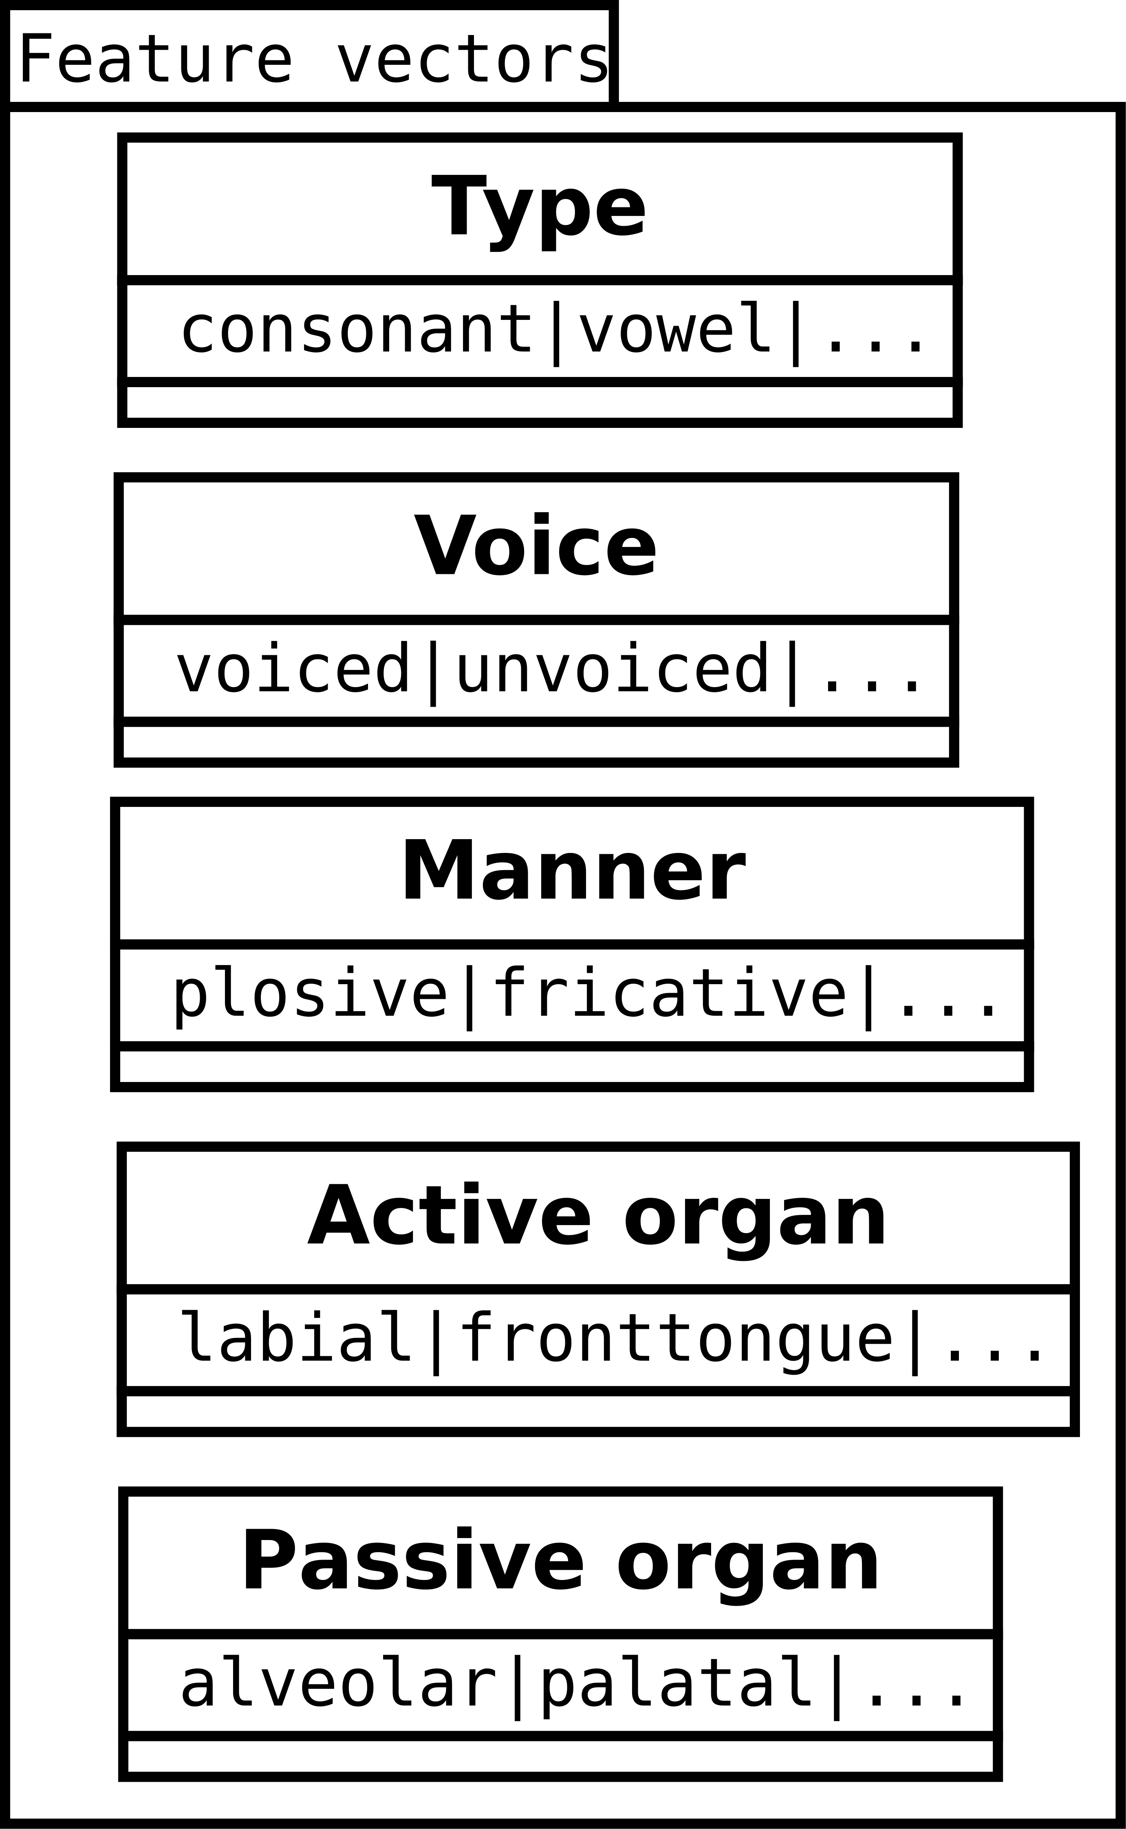
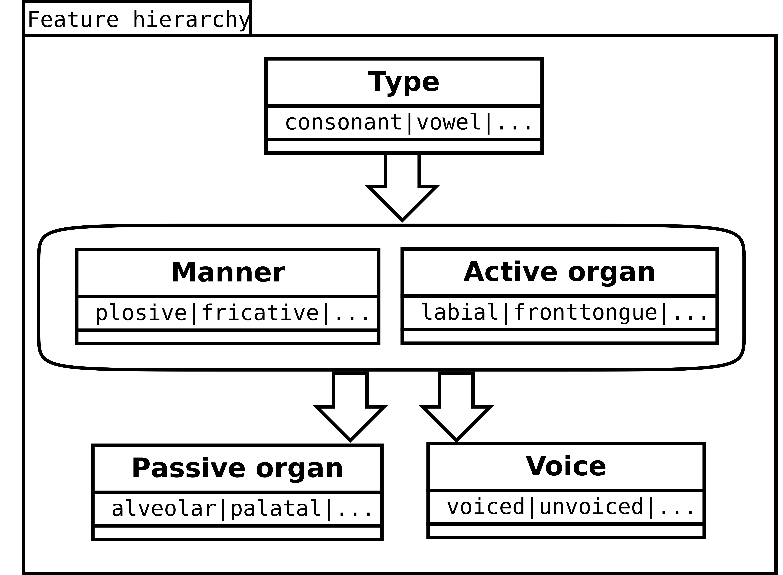
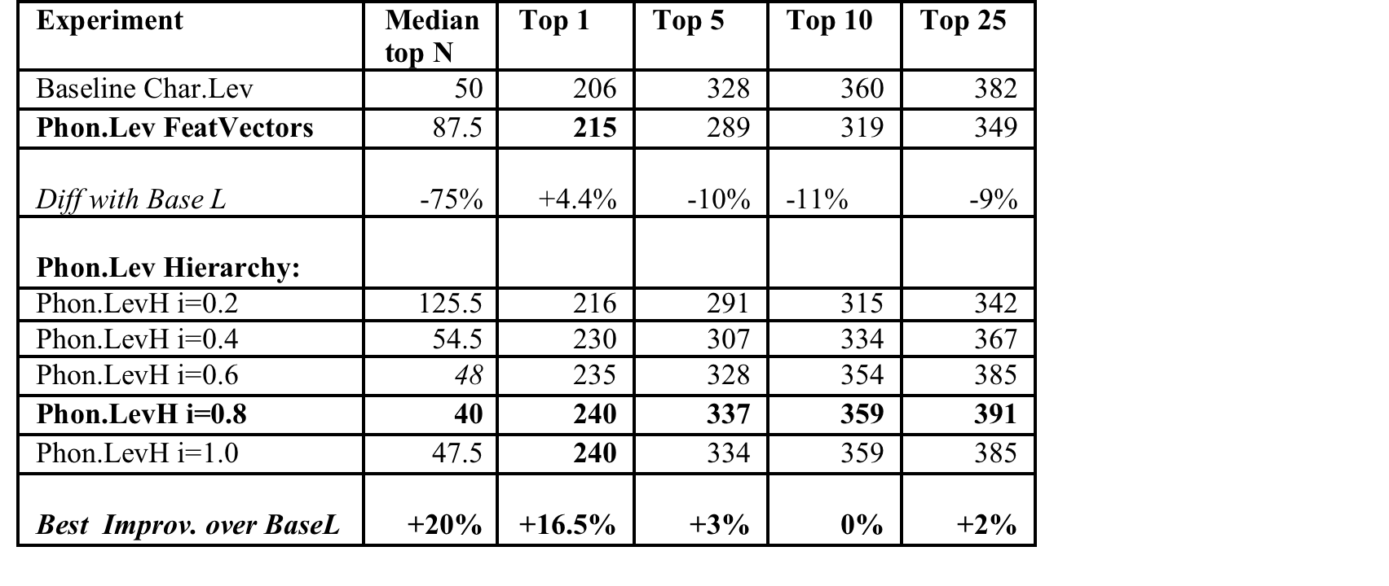
Development and evaluation of phonological models
for cognate identification
Bogdan BABYCH
Centre for Translation Studies, University of Leeds, UK
b.babych@leeds.ac.uk
Approach
Problems and solutions
Cognate identification important for Machine Translation (MT) & CAT:
Building cognate term-banks from comparable corpora;
Lexicon for closely-related & under-resourced languages;
Additional data source for statistical sentence alignment, etc…
Current methods rely on character-based distances (e.g., Levenshtein)
Count insertions, deletions, substitutions of characters;
Treat each character as an ‘atomic’ unit without structure;
Difficult to apply across different scripts (need transliteration).
Solution: phonological features of characters to calculate similarity
Characters mapped to sets of distinctive acoustic features;
Used in historical linguistics and dialectological studies;
Applied to cognate identification for MT (cf. Babych, 2016).
Large-vocabulary cognate identification ≠ historic linguistic studies
False positives due to many more plausible alternatives;
In pilot: phonological feature vectors degraded performance;
Baseline character-based Levenshtein more resistant to errors.
Some errors of Phonological Levenshtein metric due to imbalanced cost of insertion/deletion vs. substitution, e.g., for 5 phonological features:
Typical substitution cost for unrelated consonants = 0.8;
The insertion/deletion cost = 1.0 leads to under-generation of cognates with inserted/deleted characters.
We need a systematic way for development and evaluation of alternative feature models, arrangements and edit costs
(an automated framework for phonological feature engineering):
vs.
…etc.
Development and evaluation framework for phonological models
Evaluation results
Conclusions
Hierarchical phonological models improve accuracy of large-vocabulary cognate identification up to 20% on Top-N measures.
Evaluation and development framework for phonological models:
Allows for accurate feature calibration and parameter setting;
Enables a systematic task-based feature engineering.
Potential applications of the models beyond cognate identification:
Interlingual transliteration via common phonological space;
Character-based models for Neural MT;
Morphology induction & morphological variation modelling.
Future work: evaluating alternative feature topologies, integrating statistical and semantic filters for cognate identification.
Phonological models and resources (feature sets + scripts) released on https://github.com/bogdanbabych/cognates-phonology

